Slide 1



Mobile Commerce and Ubiquitous Computing Technology of E-Business

Slide 2
Learning Objectives
Discuss the value-added attributes, benefits, and fundamental drivers of m-commerce.
Discuss m-commerce applications in banking and financial services.
Describe enterprise applications.
Describe consumer and personal applications of m- commerce including entertainment.
Understand the technologies and potential applications of location-based m-commerce.
6-2

Slide 3
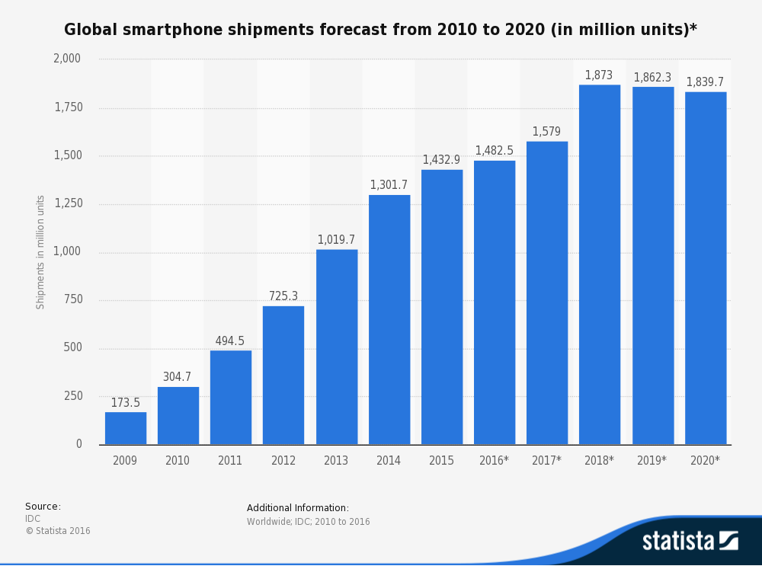

6-2

Slide 4
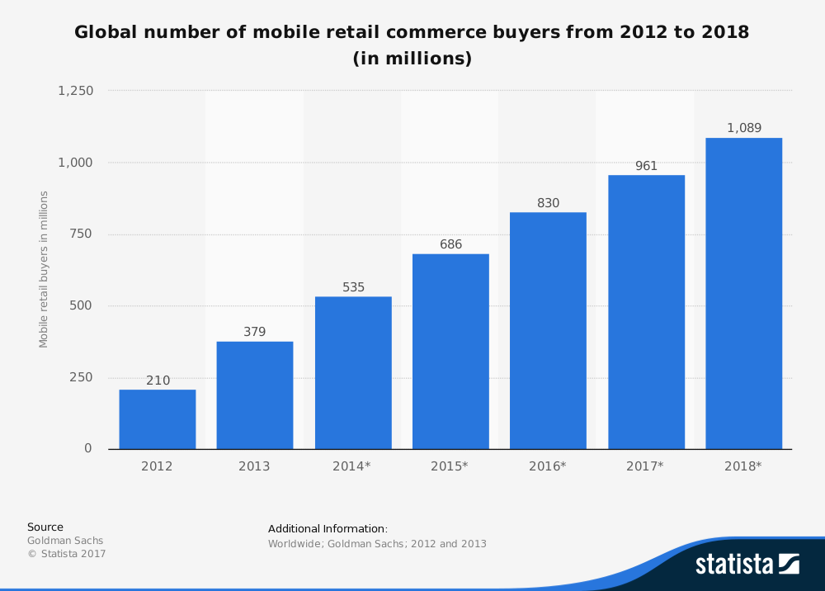
6-4

Slide 5
Mobile Commerce: Concepts
Mobile Commerce (m-commerce; m-business)
Any business activity conducted over a wireless telecommunications network or from mobile devices.
Can be done via the Internet, private communication lines, smart cards, etc.
Creates opportunity to deliver new services to existing customers and to attract new ones
6-9

Slide 6
M-Commerce: Attributes
Ubiquity—easier information access in real-time
Convenience—devices that store data and have Internet, intranet, extranet connections
Interactivity—Mobile systems allow for fast and easy interactions (e.g., via Twitter, tablets, or smartphones).
Personalization—preparation of information for individual consumers
Localization of products and services—knowing where the user is located at any given time and match service to them
6-9

Slide 7
Mobile Commerce: Drivers
Drivers of m-commerce
Widespread availability of devices ()
No need for a PC
Handset culture
Vendors’ push
Explosion of E-Commerce in general
Improved price/performance
Improvement of bandwidth
6-9

Slide 8
Mobile Commerce: Applications
The four business needs of m-commerce
Field mobility – the support of the mobile workforce
Fleet mobility – the support of vehicles in order to minimize downtime and increase effectiveness, efficiency, and utilization
Warehouse management – the improvement of the operations inside warehouses
Direct store delivery (DSD) route accounting – the increased usefulness by conducting predelivery activities (e.g. by texting information about a new shipment from the shipper to the receiver).
6-9

Slide 9
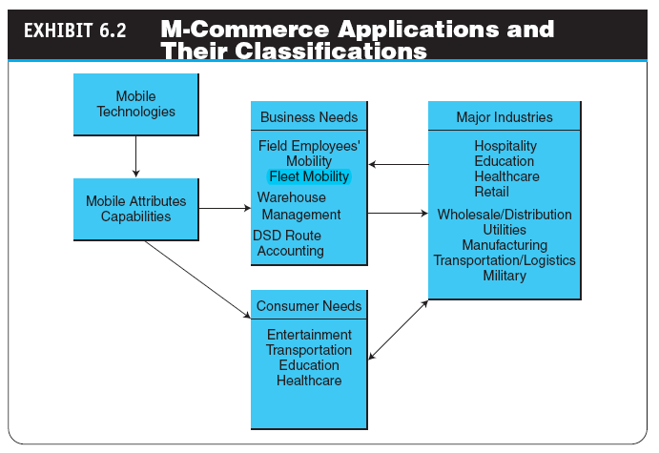
6-9

Slide 10
Mobile Commerce: Benefits
The benefits of m-commerce
Benefits for Organizations
Benefits for Individuals and Customers
Other Benefits

Slide 11
Benefits for Organizations
Increases sales due to ease of ordering by customers from anywhere, anytime.
Allows location-based commerce for more sales and revenue.
Provides an additional channel for advertising and distribution of coupons (wider reach).
Increases customers’ loyalty.
Improves customer satisfaction through real- time apps.
Enables many enterprise applications

Slide 12
Benefits for Organizations (Cont.)
Facilitates CRM and collaboration.
Reduces employee training time and help desk resources.
Improves time utilization and productivity of mobile employees.
Expedites information flow to and from mobile employees.
Delivers digitized products and services directly to mobile devices.
Reduces order-lead-time and fulfillment cycle.
Allows for lower, competitive pricing.

Slide 13
Benefits for Individuals and
Customers
Allows e-commerce from any place, anytime.
Assists in shopping by providing real time information and other shopping aids.
Helps organization of and communication while travelling.
Expedites banking and financial services.
Provides rich media entertainment anytime and anywhere.

Slide 14
Benefits for Individuals and
Customers (Cont.)
Facilitates the finding of new friends and where about of existing ones.
Provides a choice of mobile devices for transactions.
Increases affordability over the cost of using desktop computing in some countries.

Slide 15
Mobile Financial Applications
Mobile banking
Performing banking activities such as balance checks, account transactions, payments, credit applications, etc., via a mobile device
Other financial-related mobile applications
Mobile Stock Trading (i.e. Yahoo Finance, Robinhood)
Real Estate

Slide 16
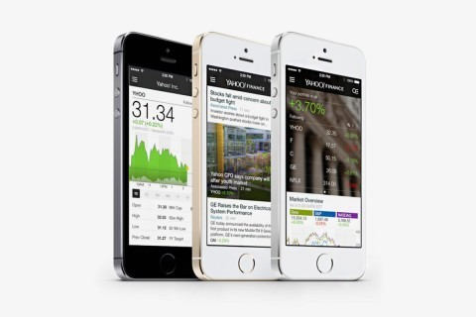

Slide 17

Mobile Financial Applications
M-wallet (mobile wallet)
a wireless wallet that enables cardholders to make purchases with a single click from their wireless devices
Using apple pay
Use your phone instead of a card at the ATM

Slide 18
Mobile Enterprise Solutions
Defining mobile enterprise
mobile enterprise
Application of mobile computing inside the enterprise (e.g., for improved communication among employees)
The framework and content of mobile enterprise applications
The sales application
The support application
The service application
mobile worker
Any employee who is away from his or her primary work space at least 10 hours a week or 25 percent of the time

Slide 19
Mobile Enterprise Solutions
Mobile Capture: Mobilize Your Business Processes

Slide 20
Mobile Enterprise Solutions
Benefits of
Mobile Workforce Support
Sales force automation
Field force automation
Mobile office applications
Mobile CRM (e-CRM)
Challenges of
Mobile Workforce Support
Network coverage gaps and interruptions
Internetwork roaming
Device and network management
Bandwidth management

Slide 21
Mobile Enterprise Solutions
Fleet and transportation management
Fleet Maintenance
Tracking People and Vehicles
Transportation Management

Slide 22
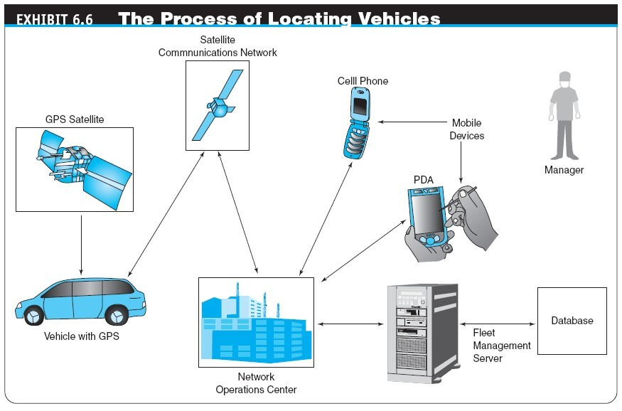

Slide 23
Mobile Entertainment
mobile entertainment
Any type of leisure activity () that utilizes wireless telecommunication networks, interacts with service providers, and incurs a cost upon usage
Mobile music and video providers
Mobile games
Hurdles for Growth
Mobility and sports

Slide 24
Mobile Consumer Services
Service industry consumer applications
Health Care
Hospitality Management
Public Safety and Crime Prevention
Other Industries

Slide 25
Location-Based Mobile Commerce
location-based m-commerce (l-commerce)
Delivery of m-commerce transactions to individuals in a specific location, at a specific time
real-time location system (RTLS)
Systems used to track and identify the location of objects in real time

Slide 26
Location-Based Mobile Commerce
L-Commerce infrastructure
Mobile devices
Communication network
Positioning component
Service or application provider
Data or content provider

Slide 27
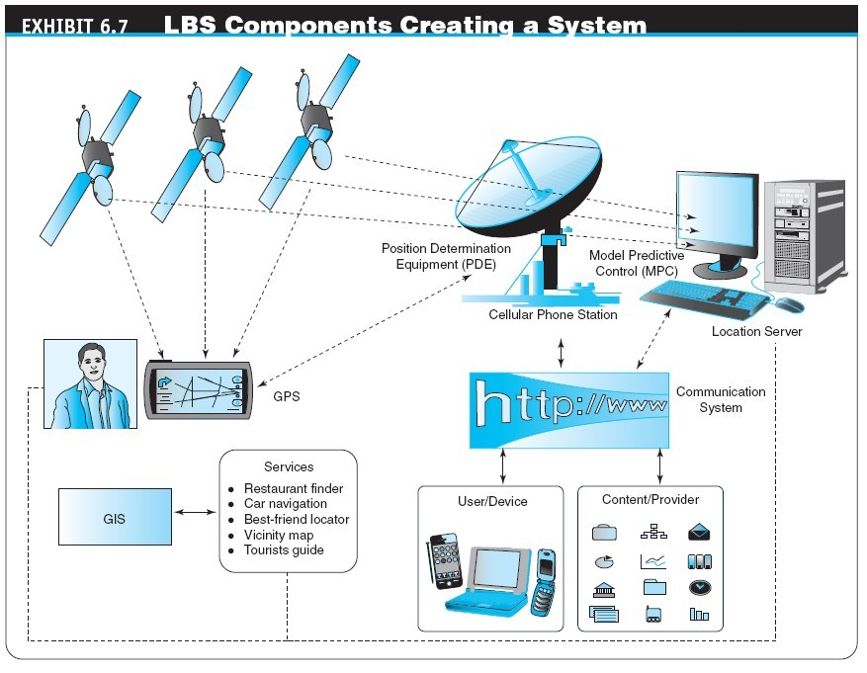

Slide 28
Location-Based Mobile Commerce
Location-Based Data
Locating
Navigating
Searching
Identifying
Event checking
What are Location Based Services?

Slide 29
Location-Based Mobile Commerce
location-based service (LBS)
An information service accessible from and to mobile devices through a mobile network utilizing the ability to make use of the geographical position of the mobile device to deliver a service to the user
automatic vehicle location (AVL)
A means for automatically determining the geographic location of a vehicle and transmitting the information to a request
social location-based marketing
Marketing activities that are related to social behavior and are related to social networking activities

Slide 30
Examples of Location-Based Services
For the mobile user, some examples of location- based services are:
Requesting the nearest business or service, such as an ATM or restaurant.
Receiving alerts, such as notification of a sale on gas or warning of a traffic jam
Finding a buddy
6-30

Slide 31
Barriers to location-based m-
commerce
lack of GPS in mobile phones
accuracy of devices
the cost–benefit justification
limited network bandwidth
invasion of privacy
6-30

Slide 32
Q & A
6-30

